Slide 1


MILESTONE PROJECT -1 - SALARY DATA ANALYSIS(2021)
CS Sundhar
DADS March-25

Slide 2



PRIMARY OBJECTIVES
Removed Duplicates
Outlier Detection
Data Cleaning
Column Categorization
CSV to MySQL
Query Execution
Exported Tables
Pivot & Charts
Dashboard Creation
User Engagement
Seamless Workflow
Slicer Integration

Slide 3
INTRODUCTION TO DATASET
Age range – Grouped age bracket of the person
Industry – General work sector (e.g., Tech, Finance)
CATEGORY OF INDUSTRY – Specific type within industry
Job title – Position or role name (e.g., Manager)
Annual salary – Yearly base pay
Additional Monetary Compensation – Bonus or extra income
Currency – Type of money used (e.g., USD)
Country – Nation where the person works
Region – Larger area within the country
State – Sub-region or state
City – Specific city of work
Years of professional experience overall – Total work years
OVERALL LEVEL – Experience level (e.g., Junior, Mid)
Years of professional experience in field – Work years in same field
FIELD LEVEL – Skill level in current field
Highest level of education completed – Education qualification
Gender – Gender identity (e.g., Male, Female, Others)
Final salary – Total income (salary + extras)
Salary Category – Grouped salary range (e.g., 50k-1L,1L-5L)

Slide 4
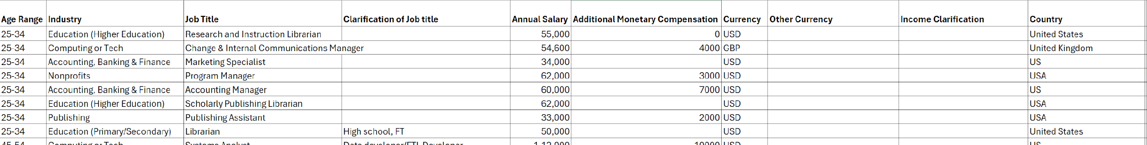
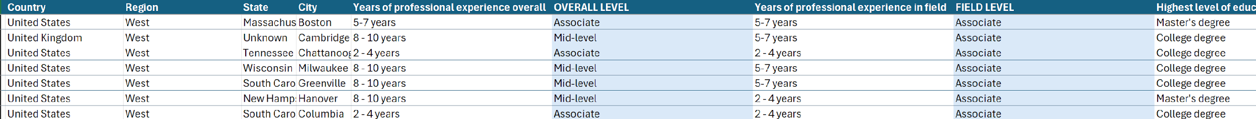
CLEANED AND FORMATTED FILE

Slide 5
SQL & QUERIES
Created a database ‘salary data’ and created a table ‘salaries’.
Imported the csv file to MySQL via table import wizard.
After that, the queries executed and data exported back to the working file in excel

Slide 6
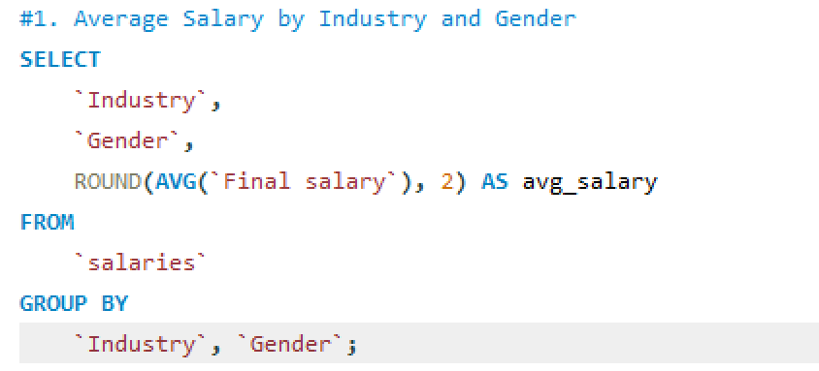
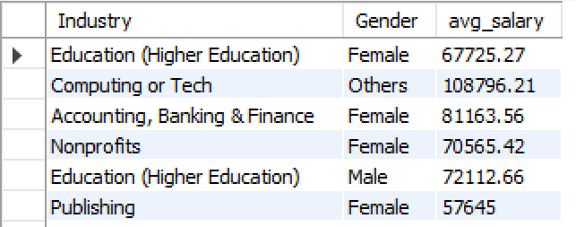
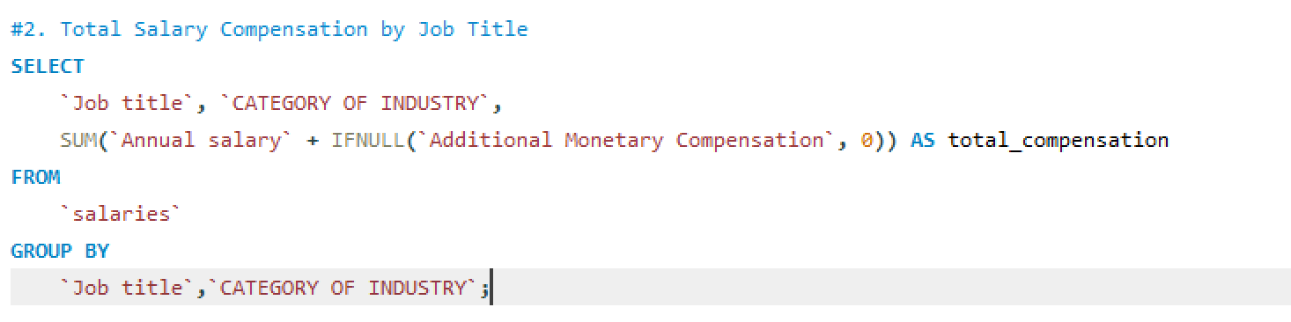
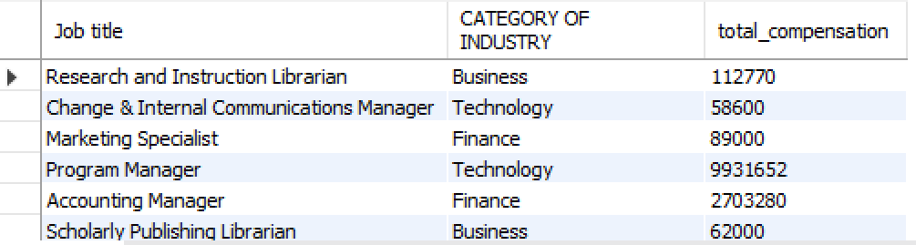
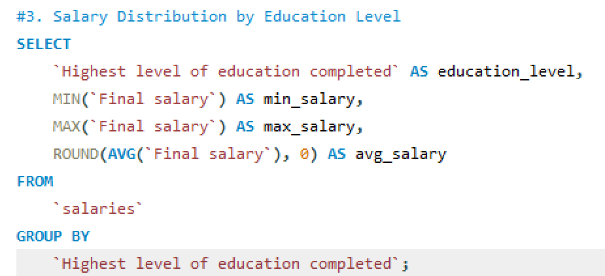
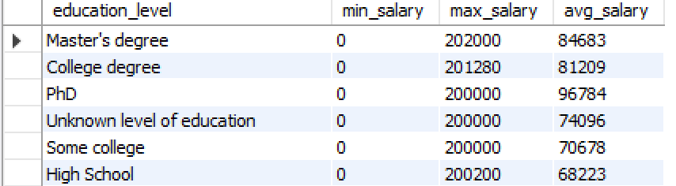
1. Average Salary by Industry and Gender
We use AVG() to find the average salary for each industry and gender.
2. Total Compensation by Job Title
We use SUM() and IFNULL() to add salary + extra money for each job title and industry.
3. Salary Range by Education
We use MIN(), MAX(), and AVG() to find lowest, highest, and average salary for each education level.

Slide 7
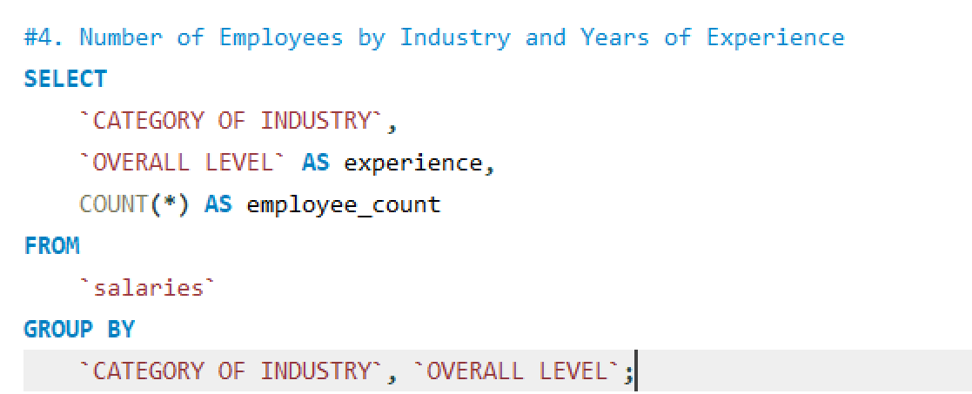
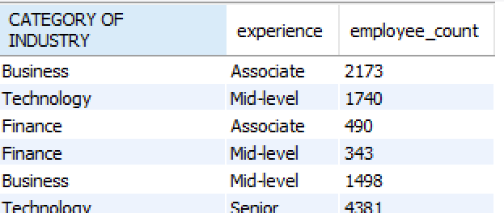
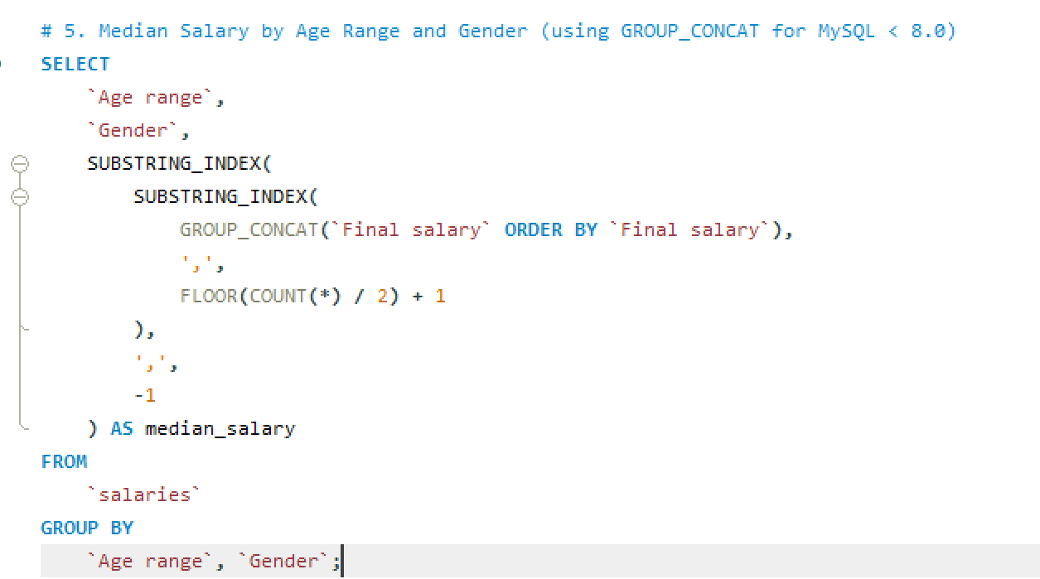
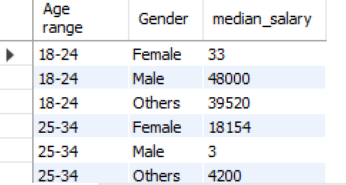
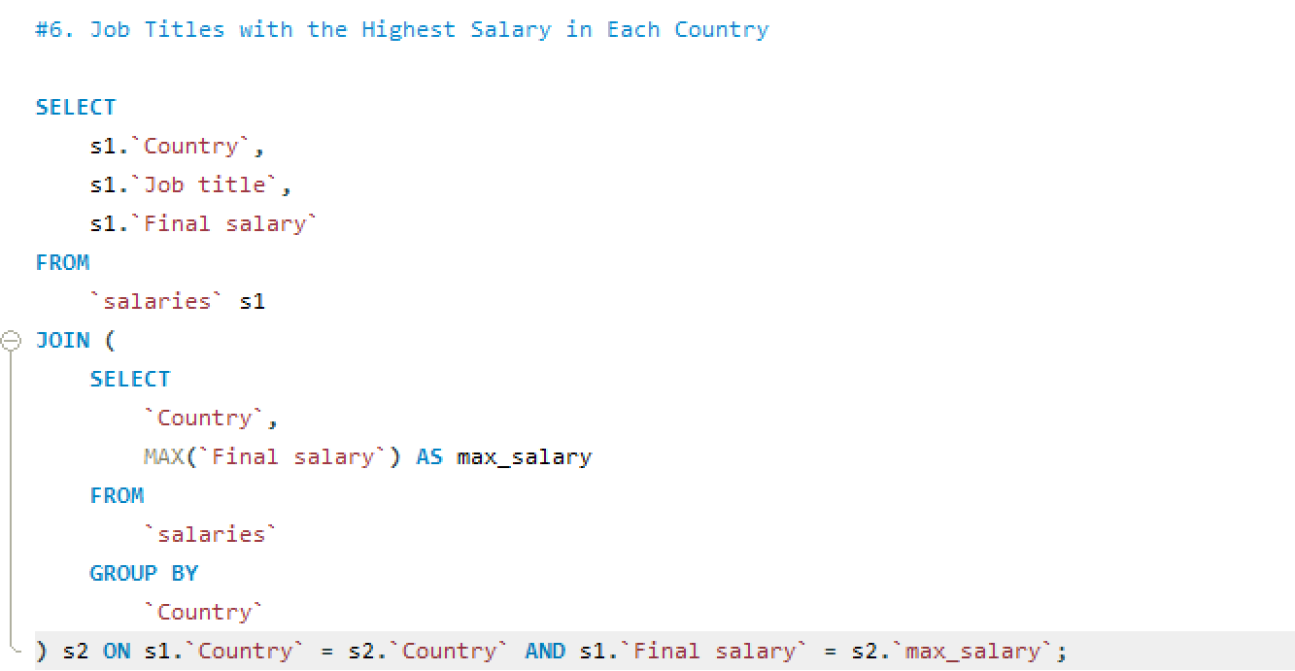
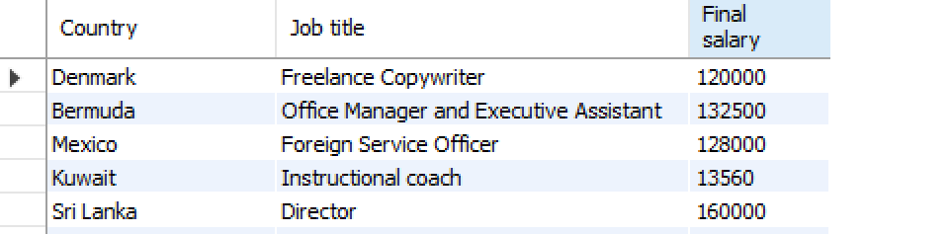
4. Employee Count by Industry and Experience
We use COUNT(*) to count how many employees are there in each industry and experience level.
5. Median Salary by Age and Gender
Since MySQL doesn't have a direct median function, we use GROUP_CONCAT() and SUBSTRING_INDEX() to get the middle salary for each age range and gender.
6. Highest Salary Job in Each Country
We use MAX() with a JOIN to find which job has the highest salary in every country.

Slide 8
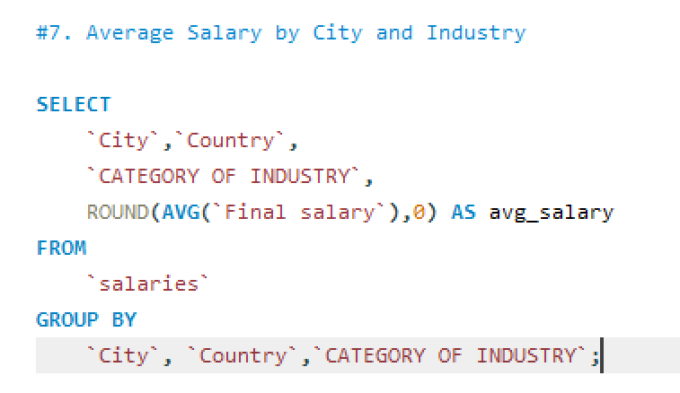
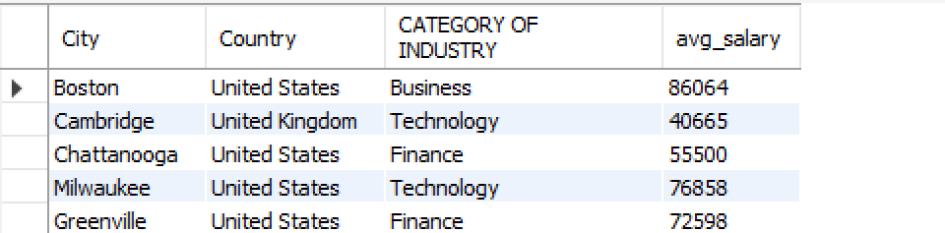
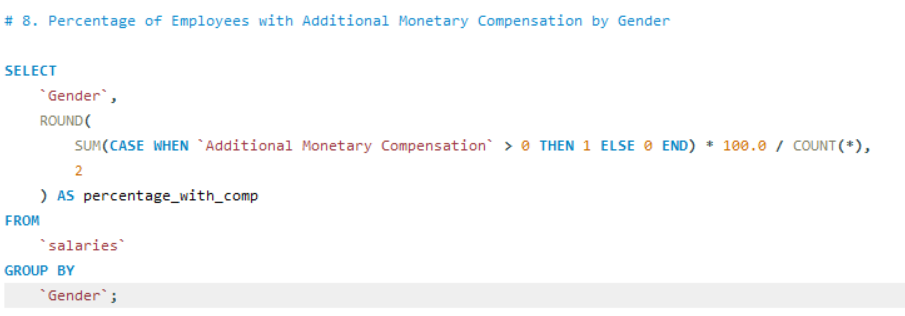
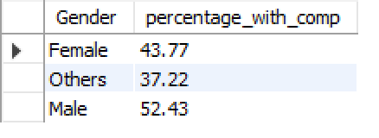
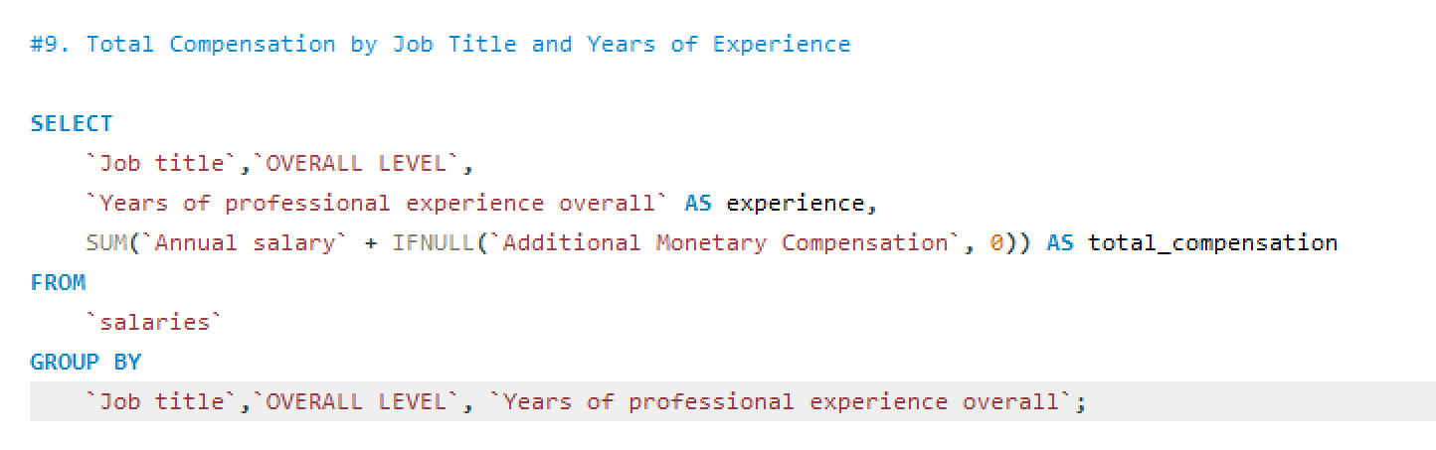
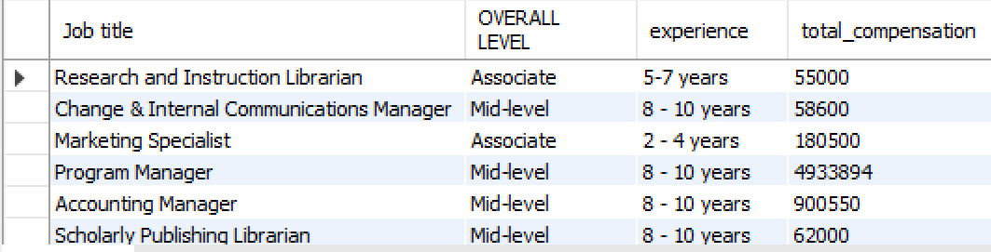
7. Average Salary by City and Industry
We use AVG() to find the average salary in every city and industry.
8. % Employees with Extra Compensation by Gender
We use CASE WHEN, SUM(), and COUNT() to find what % of people get extra money, grouped by gender.
9. Total Compensation by Job and Experience
We use SUM() to get the total salary + extra for each job and experience level.

Slide 9
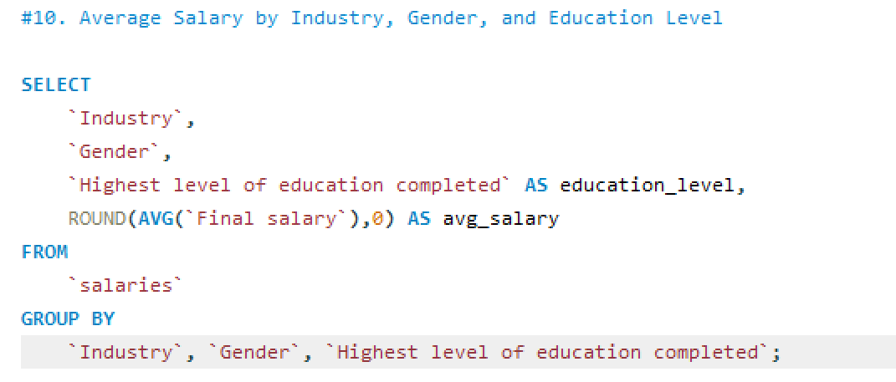
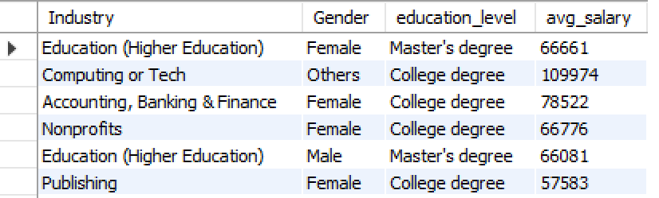
10. Average Salary by Industry, Gender, and Education
We use AVG() to see the average salary for every combination of industry, gender, and education level.

Slide 10
PIVOT TABLE AND CHARTS
Industry-wise Salary Insights Showed average and total compensation (salary + additional pay) across industries.
Education vs Salary Compared salary distribution based on education levels.
Workforce Distribution Analyzed employee count across different industries.

Slide 11
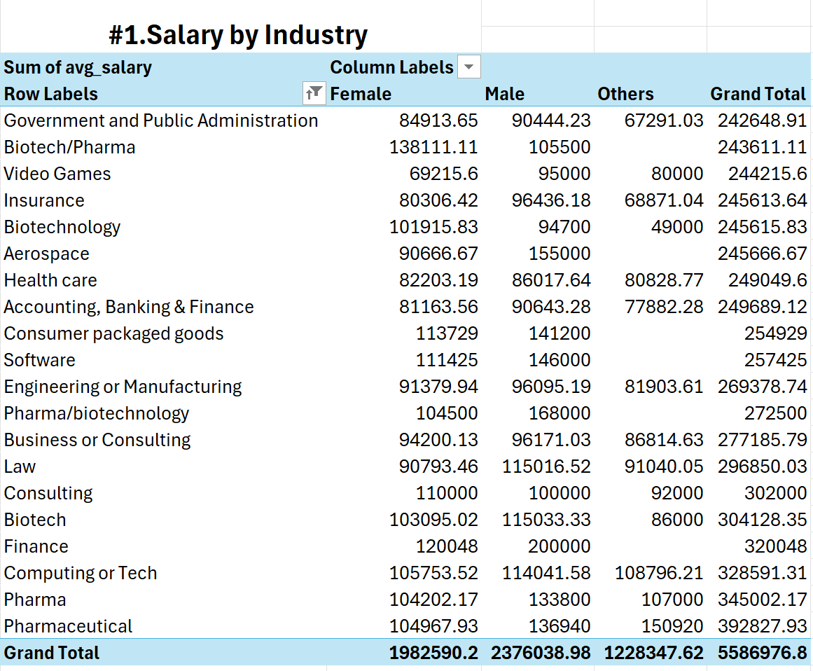
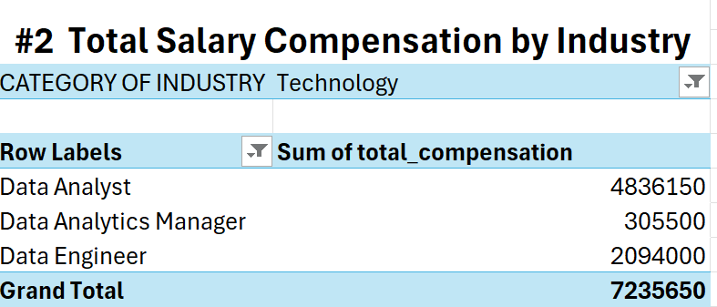
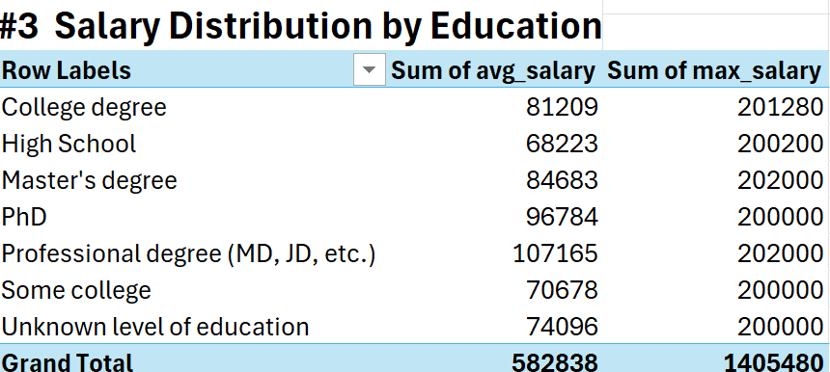
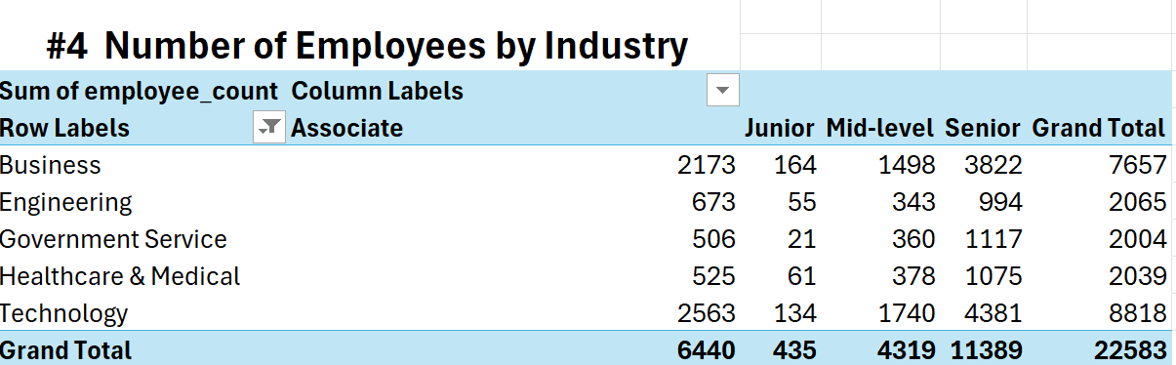

Slide 12
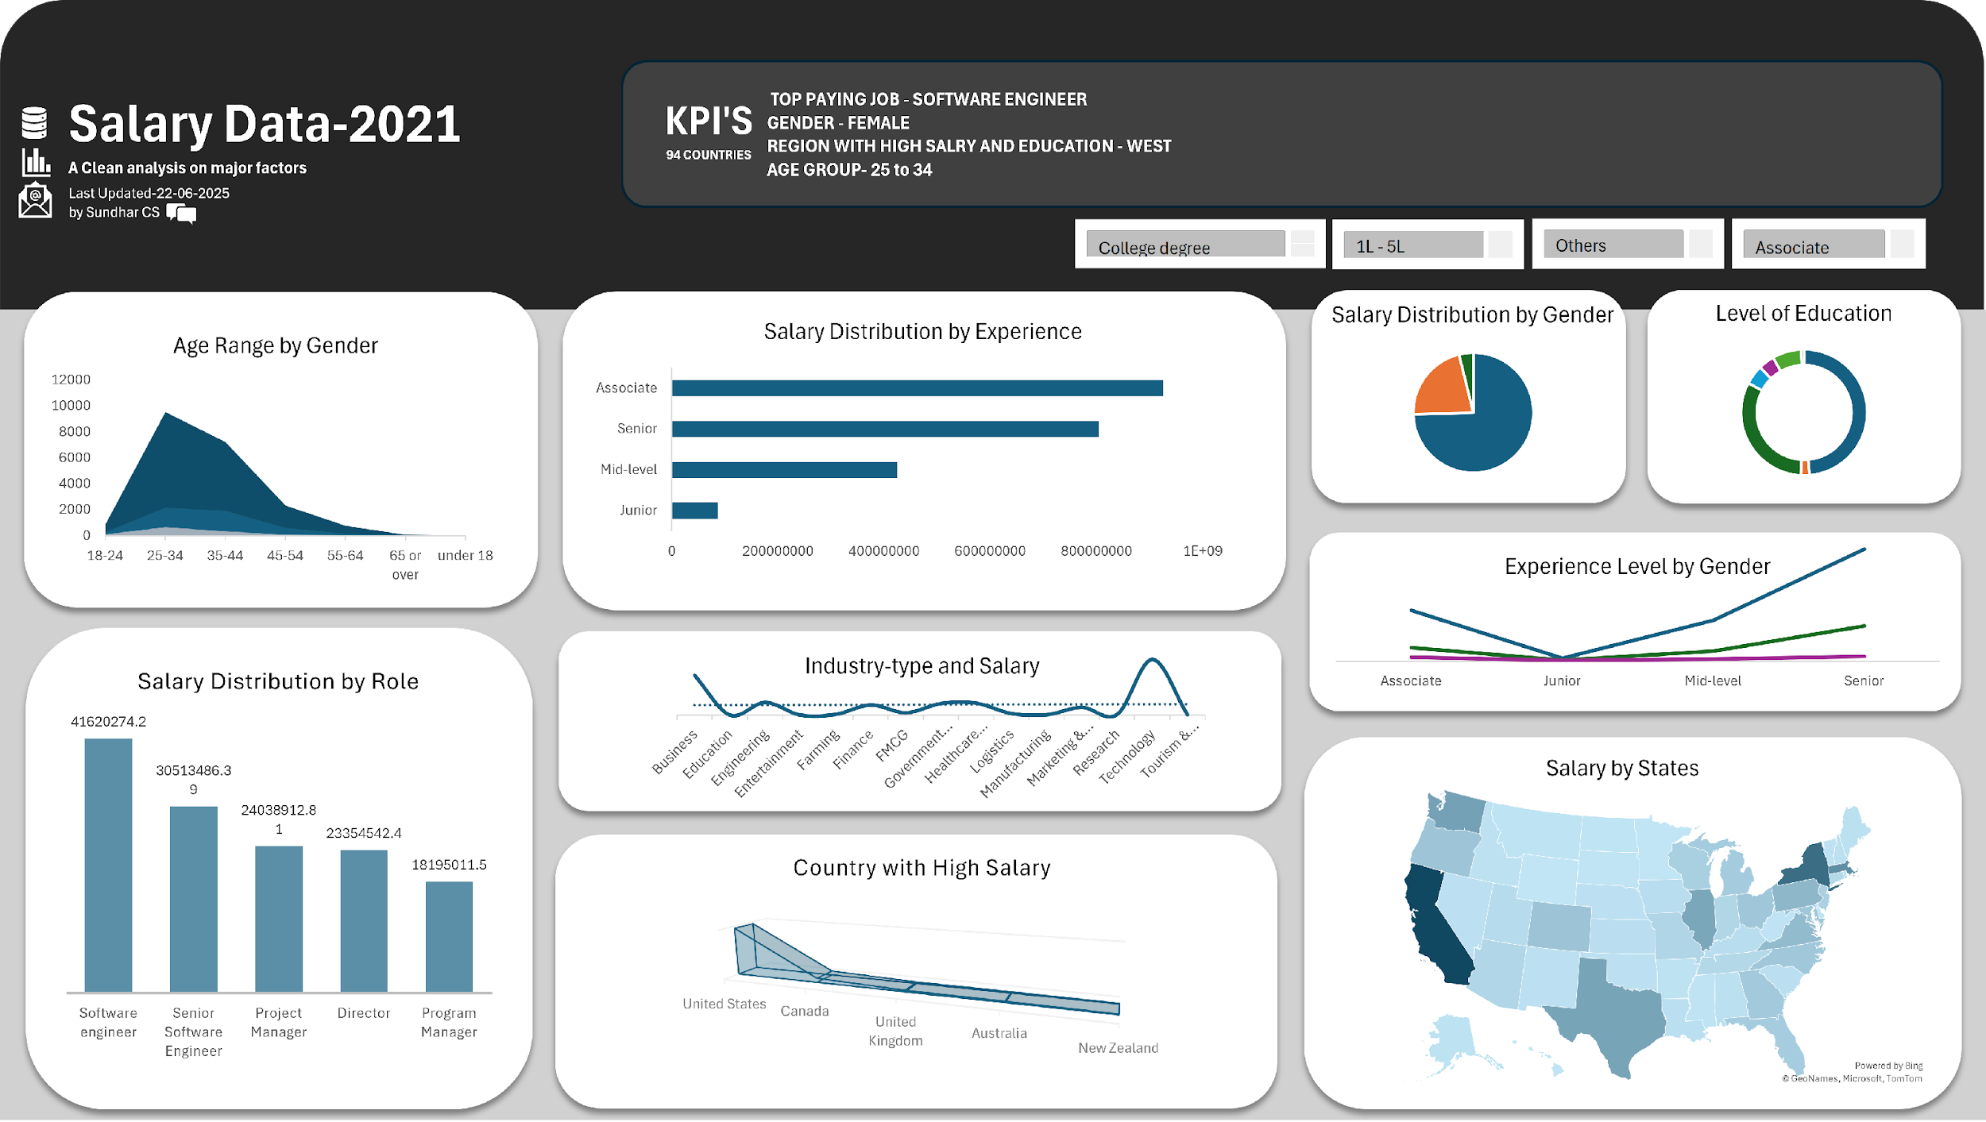
DASHBOARD

Slide 13
INSIGHTS AND RECOMMENDATIONS
Key Insights
Dominant Age Group: Majority of employees are aged 25–34, typically holding Associate-level roles, indicating early-to-mid career professionals.
Salary Distribution: Associates contribute the highest total salary sums across industries, highlighting their key role in the workforce.
Gender Representation: The dataset reveals a higher proportion of female employees compared to male and others.
Education Requirement: A basic college degree is the minimum qualification for most roles.

Slide 14
Career Growth (Females): Female professionals demonstrate strong career progression, from entry-level roles to directorial positions.
Top-Paying Role: Software Engineers earn the highest salaries across all job titles.
Industry Trends: Business and Technology sectors show higher opportunities and growth compared to Logistics, FMCG, and Farming.
Top Paying Country: The United States stands out as the country with the highest employee compensation.
High-Earning Location: Employees in California are notably higher paid and generally more educated

Slide 15
Recommendations
Focus on Associate-Level Development: Provide upskilling and leadership programs for associates to retain and grow top talent.
Support Female Career Advancement: Promote policies that support women’s career growth into leadership roles.
Invest in Business & Tech Fields: Encourage training in Business Analytics, Data Science, and Software Development to match market demand.
Promote U.S. Market Strategy: For global expansion, consider focusing efforts in the U.S. job market, particularly California.
Encourage Early-Career Talent: Target professionals aged 25–34 with career path planning and learning initiatives.

Slide 16
CONCLUSION
👥 Core Workforce
Age Group: 25–34 years
Role Focus: Associate-level professionals
Gender Highlight: Female employees showing strong presence and growth
💼 Top Industries
Technology
Business
High salary potential and growth opportunities

Slide 17
🌍 Geographic Trends
Country: United States
State Focus: California
High compensation
Highly educated workforce
📈 Strategic Recommendations
Invest in Associate Development
Upskilling and leadership paths
Support Diverse Talent
Promote gender-inclusive policies
Align Training with Demand
Focus on Business & Tech skills

Slide 18
Your Thoughts Matter!

Slide 19
😁THANK YOU👍

